Slide 1

INTERNAL ASSESSMENT-EXCEL
Trivikraman S
4400

Slide 2
Question 1
This is the gender-ethnicity distribution in the company
The company has highest numbers in Asian ethnicity
It has great focus in female numbers
Female | 518
Asian | 207
Black | 37
Caucasian | 140
Latino | 134
Male | 482
Asian | 197
Black | 37
Caucasian | 131
Latino | 117

Slide 3
DEPARTMENT-WISE
Female | Accounting | 53
 | Engineering | 80
 | Finance | 69
 | Human Resources | 64
 | IT | 119
 | Marketing | 57
 | Sales | 76
Female Total |  | 518
Male | Accounting | 43
 | Engineering | 78
 | Finance | 51
 | Human Resources | 61
 | IT | 122
 | Marketing | 63
 | Sales | 64
Male Total |  | 482
The company has focussed women count/hiring in the Sales department

Slide 4
QUESTION 3
Department | Sum of Annual Salary
Accounting | 11822107
Engineering | 17227563
Finance | 14736347
Human Resources | 14757305
IT | 23567499
Marketing | 15559564
Sales | 15546980
Yes there is a significant difference
IT department draws the highest salary out of all the departments

Slide 5
QUESTION 4
Country | Count of EEID
Brazil | 139
China | 218
United States | 643
Company has highest number of employees from the United States

Slide 6
Question 5
25-34 | 245
35-44 | 227
45-54 | 296
55-65 | 232
Highest number of employees are in the age group 45-54
Shows that the company values
Experienced professionals a lot

Slide 7
QUESTION 6
=AVERAGE(K:K)
This the formula used to calculate the average of the bonus payout percentage
The answer is 0.08866 which is around 8.8%

Slide 8
QUESTION 7
Job Title | Count of EEID
Director | 121
Director has the most occurrence in the job title

Slide 9
QUESTION 8
0 % bonus payout is the main reason for the employee exit from the company
Filtering out the employees based on the exit date and 0 percent bonus payout gives this insight

Slide 10
Question 9
Human Resources | 125
Asian | 50
Black | 14
Caucasian | 28
Latino | 33
Sales | 140
Asian | 58
Black | 13
Caucasian | 32
Latino | 37
Human Resources and Sales department has diverse employees as it deals with people of different backgrounds and ethnicity

Slide 11
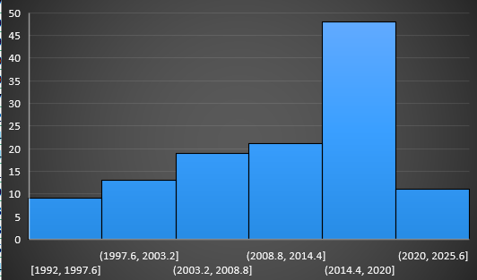
Question 10
There seems to be significant hiring during the 2014-2020 period
But the hiring has seen a downfall during the period 2020-present
So there is a decrease in number of hires in past few years

